Slide 1
US-China two-country stock flow consistent model
First, we present a model of an open economy under a regime of fixed exchange rates, with no private international capital flows. It can be interpreted as a small open economy.
In addition, this model will show that reductions or increases in foreign exchange reserves, as a result of foreign exchange interventions by the central bank to keep the exchange rate fixed, have no effect on the money supply. In other words, foreign exchange interventions by central banks are "automatically" sterilize.
The way in which this model works will prepare the ground for a more complex model, presented in the second part, in which the exchange rate is determined by demand and supply for internationally tradable financial assets and in which changes in the exchange rate feed back to help determine trade and all other flows as sequences in real time.
It will also be shown how this more complex model can be extended to a fixed exchange regime.

Slide 2
US-China two-country stock flow consistent model
It may be tempting to compare the present analysis to the standard Mundell-Fleming models (the IS-LM-BP models).
But comparisons are hard to come by. Mundell (1963) assumes perfect capital mobility and perfect asset substitutability, whereas we assume only the former so that capital flows generated by differing rates of return cannot go on forever.
Mundell (ibid.) and Fleming (1962), along with their textbook representations, assume that monetary policy is best represented by purchases and sales of securities on the open market, whereas we assume that interest rate targeting best represents monetary policy.
Finally, we make explicit the interdependence of all variables within a stock-flow approach, whereas the standard textbook approach does not.

Slide 3
US-China two-country stock flow consistent model
The economy is assumed to comprise firms, households, a foreign sector, and a government with a separate central bank.
Imports are determined by the import propensity and income.
Consumption each period is determined by disposable income and the stock of wealth inherited from the previous period.
Investment is set aside because its inclusion in our framework requires a complete yet simplified representation of the way in which investment is financed and a large number of additional equations. Its inclusion would not change our essential conclusions because net investment would need to be equal to zero once a long-run equilibrium has been reached, unless we moved the analysis to growth models.

Slide 4
US-China two-country stock flow consistent model
Transaction and balance sheet matrices of a simplified economy with capital controls
Flows per period
Sectors | Households | Firms | Central Bank | Government | Foreign | Sum
National accounts |  |  |  |  |  | 0
Consumption | -C | +C |  |  |  | 0
Government |  | +G |  | -G |  | 0
Exports |  | +X |  |  | -X | 0
Imports |  | -IM |  |  | +IM | 0
Total income/output | +Y | -Y |  |  |  | 0
Taxes | -T |  |  | +T |  | 0
Flow of funds |  |  |  |  |  | 0
Changes in |  |  |  |  |  | 0
T-bills | -ΔBp |  | -ΔBcb | +ΔB |  | 0
Cash | -ΔH |  | +ΔH |  |  | 0
Foreign exchange reserves |  |  | -ΔR |  | +ΔR | 0
Sum | 0 | 0 | 0 | 0 | 0 | 0
Changes in |  |  |  |  |  | 0
Total wealth/debt | +ΔV | 0 | 0 | -ΔB | -ΔR | 0
Balance sheets(stocks) at end of period |  |  |  |  |  | 0
T-bills | +Bp |  | +Bcb | -B |  | 0
Cash | +H |  | -H |  |  | 0
Foreign exchange reserves |  |  | +R |  |  | 0
Sum = Total wealth/debt | +V | 0 | 0 | -B | -R | 0

Slide 5
US-China two-country stock flow consistent model
我们的简单模型是递归的，在不考虑资金流动和投资组合选择的情况下确定国民账户流量。系统的其余部分如何组合在一起？ 现在，我们继续讨论模型的财务方面。每个时期的储蓄，连同期初的财富存量，创造了一个新的期末财富存量，个人部门按照外生利率决定的比例在现金和国库券之间分配。 为简单起见，假设没有交易需要现金。 数组中的系数根据托宾式加法原理进行约束，因此常数之和等于 1，另一列之和为零。 政府出售（发行）额外的国库券以弥补任何赤字。 根据标准的后凯恩斯主义理论，并符合一些新凯恩斯主义者所拥护的新“共识观点”，我们假设利率是由中央银行设定和管理的。在利率不变的情况下，央行必须根据需求将国库券兑换成任何规模的现金。

Slide 6
US-China two-country stock flow consistent model
We assume that the Bank will hold any amount of Treasury bills that the private sector is unwilling to hold at the target rate of interest.
Thus, the Treasury and the monetary authorities do not decide what proportion of the public debt ought to be "monetized," if we dare use the wording of mainstream authors. This proportion is determined endogenously by the portfolio decisions of the private sector and the evolution of the external balance, once the target rate of interest has been set by the central bank.
The central bank holds two kinds of assets, namely, domestic and foreign Treasury bills, the latter being the foreign reserves of the domestic economy. Any imbalance in trade (because there are no capital flows) implies an equivalent change in the stock of foreign reserves.
The supply of cash is implied by the Bank's balance sheet.
There is neither a need nor a place for an equation (the "redundant" equation) to make the demand for money equal to the supply. The money stock is thus comprehensively endogenous; it is what the central bank finds itself supplying, given the demand for money.

Slide 7
US-China two-country stock flow consistent model
A major feature of this model is that there is nothing in it, no self-correcting mechanism, to make exports equal to imports. In general, once the steady-state level of income has been reached, trade will still be unbalanced, which implies that this solution is instead a quasi steady state, because some stocks will still be changing, namely, the central bank stock of foreign reserves and the stock of government debt.
We give a numerical example of what would happen, according to our simple model, if exports were to jump by u5. In the first period, the balance of trade would improve by u3, and the budget balance by u1.6.
Our SFC model shows how "sterilization" would occur automatically and endogenously, being the consequence of the central bank decision to keep interest rates at a given level, which is how central banks function in the real world. The reduction in the holdings of Treasury bills by the central bank compensates for the increase in foreign reserves that is not accompanied by an increase in money demand.

Slide 8
US-China two-country stock flow consistent model
In a (quasi) steady state, a trade deficit will be accompanied by an equivalent budget deficit, and, conversely, that a trade surplus will be associated with a budget surplus.
In the case of a trade deficit, as long as private capital flows are not allowed, there are no means to finance a trade deficit after the reserves of the central bank have become exhausted. A possible response, when reserves run out, will be to restrict demand, using fiscal policy, to the point where exports equal imports, IM- X = 0. In this case, we end up with the super steady state where all stocks as well as all flows are constant.
The situation is, however, different when countries are running trade surpluses.
Take the case of China with its exchange rate fixed to the U.S. dollar and its huge balance-of-payments surplus. The country is accumulating enormous additions to its foreign reserves. The People's Bank of China is still able to control interest rates, the economy is not being flooded with liquidity, and hence there is no inherent corrective mechanism, save continued expansion, that would bring about a balanced trade account.

Slide 9
US-China two-country stock flow consistent model
The Chinese economy can continue to run balance-of-payments surpluses forever, if its government leaders are happy to accumulate U.S. financial assets.
There is no mechanism, neither a price mechanism nor a quantity mechanism, that will force the surplus countries to converge toward a balanced current account.
The Chinese financial system being an "overdraft" system, commercial banks are indebted to the central bank.
When the country is running a balance-of-payments surplus, commercial banks can use their foreign currency holdings to reduce their indebtedness vis-a-vis the central bank.
Sterilization thus occurs in large part at the initiative of the commercial bank sector-sterilization is endogenous.

Slide 10
US-China two-country stock flow consistent model
A major contradiction between the compensation thesis and the Mundell-Fleming model is about whether there is some inherent corrective mechanism to bring a trade surplus back to a balanced trade account.
According to the Mundell-Fleming model, for a country with fixed exchange rate and trade surplus (China), there is an intrinsic corrective mechanism that would bring about a balanced trade account.
On the contrary, according to the compensation thesis, the Chinese economy can continue to run trade surpluses forever. There is no mechanism that will force China to converge toward a balanced current account.

Slide 11
US-China two-country stock flow consistent model
该模型旨在成为 SFC 标准，并尽可能简单地帮助阐述，以便隔离两个被证明是核心的特征。第一个是两国（美国、中国）的居民都可以买卖外国金融资产（外国政府发行的国库券）。第二个是，当中央银行确定利率时，绝育成为内生的。 如果中央银行不购买或动用储备——也就是说，如果存在“干净的”浮动——该模型的解决方案将需要改变汇率。 同样显而易见的是，如果不考虑世界其他地区的所有反应，就不可能解决一个国家的模式。 每个国家政府发行的国库券都可以由任何一个国家的居民购买。 xru 是每 u 的 c 数字（以 c 货币表示的 u 值）。 钞票有两个后缀，第一个后缀是指国库券所在的国家，第二个后缀是指国库券发行国。例如，Buc 是由 c 财政部发行的在 u 国家持有的国库券。

Slide 12
Transaction matrix in US-China two-country economy

Slide 13
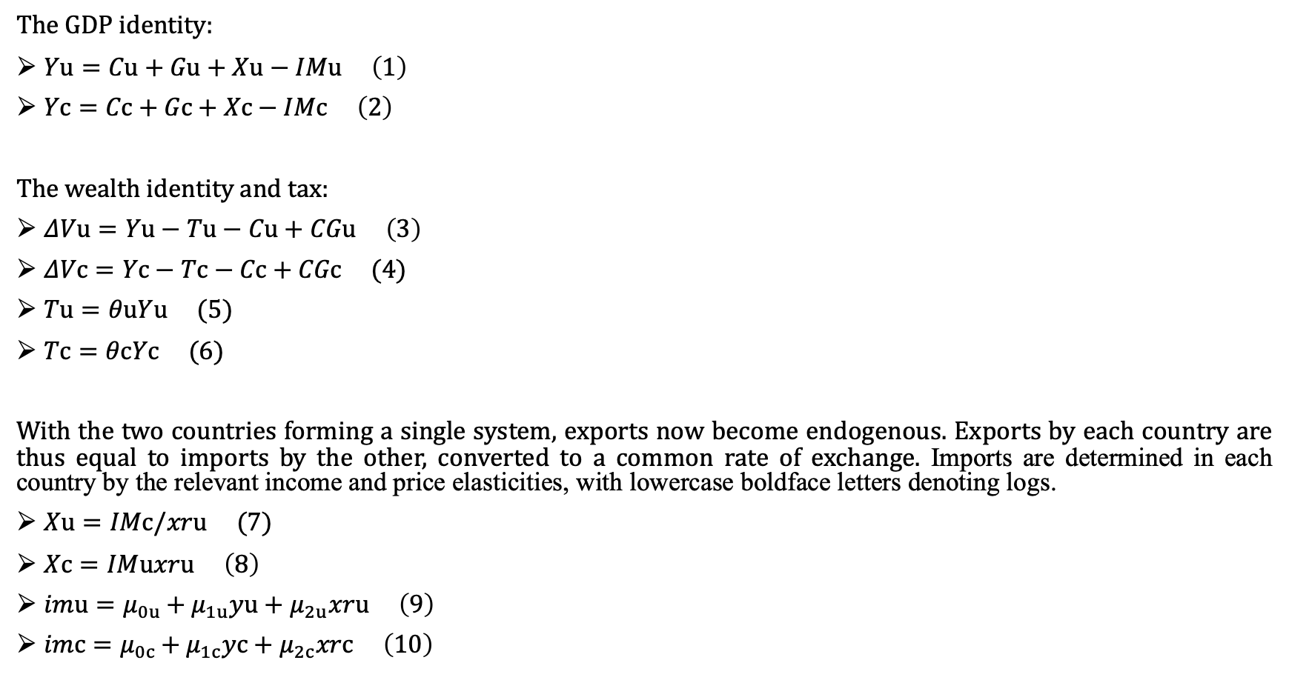
Behavior functions
The GDP identity:
$Yu=Cu+Gu+Xu−IMu \left(1\right)$
$Yc=Cc+Gc+Xc−IMc \left(2\right)$
The wealth identity and tax:
$ΔVu=Yu−Tu−Cu+CGu \left(3\right)$
$ΔVc=Yc−Tc−Cc+CGc (4)$
$Tu=θuYu (5)$
$Tc=θcYc (6)$
With the two countries forming a single system, exports now become endogenous. Exports by each country are thus equal to imports by the other, converted to a common rate of exchange. Imports are determined in each country by the relevant income and price elasticities, with lowercase boldface letters denoting logs.
$Xu=IMc/xru (7)$
$Xc=IMuxru \left(8\right)$
$imu=μ_{0u}+μ_{1u}yu+μ_{2u}xru \left(9\right)$
$imc=μ_{0c}+μ_{1c}yc+μ_{2c}xrc \left(10\right)$

Slide 14
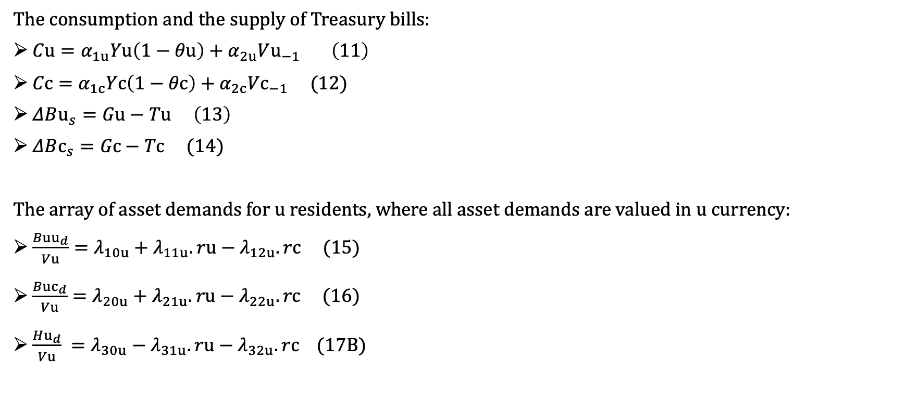
Behavior functions
The consumption and the supply of Treasury bills:
$Cu=α_{1u}Yu\left(1−θu\right)+α_{2u}Vu_{−1} \left(11\right)$
$Cc=α_{1c}Yc\left(1−θc\right)+α_{2c}Vc_{−1} (12)$
$ΔBu_{s}=Gu−Tu \left(13\right)$
$ΔBc_{s}=Gc−Tc (14)$
The array of asset demands for u residents, where all asset demands are valued in u currency:
$\begin{aligned}\frac{Buu_{d}}{Vu}=λ_{10u}+λ_{11u}.ru−λ_{12u}.rc (15)\end{aligned}$
$\begin{aligned}\frac{Buc_{d}}{Vu}=λ_{20u}+λ_{21u}.ru−λ_{22u}.rc (16)\end{aligned}$
$\frac{Hu_{d}}{Vu} =λ_{30u}−λ_{31u}.ru−λ_{32u}.rc (17B)$

Slide 15
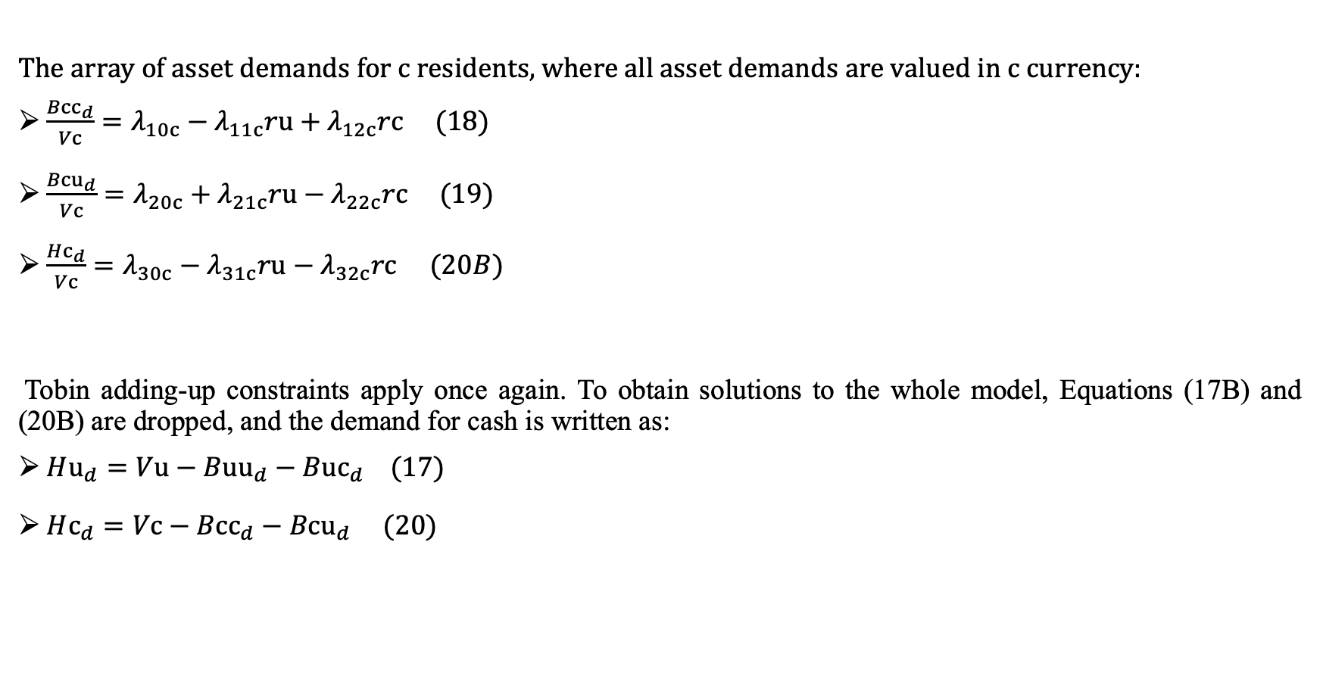
Behavior functions
The array of asset demands for $c$ residents, where all asset demands are valued in c currency:
$\frac{Bcc_{d}}{Vc}=λ_{10c}−λ_{11c}ru+λ_{12c}rc (18)$
$\frac{Bcu_{d}}{Vc}=λ_{20c}+λ_{21c}ru−λ_{22c}rc (19)$
$\frac{Hc_{d}}{Vc}=λ_{30c}−λ_{31c}ru−λ_{32c}rc$ $(20B)$
Tobin adding-up constraints apply once again. To obtain solutions to the whole model, Equations (17B) and (20B) are dropped, and the demand for cash is written as:
$Hu_{d}=Vu−Buu_{d}−Buc_{d} (17)$
$Hc_{d}=Vc−Bcc_{d}−Bcu_{d} (20)$

Slide 16
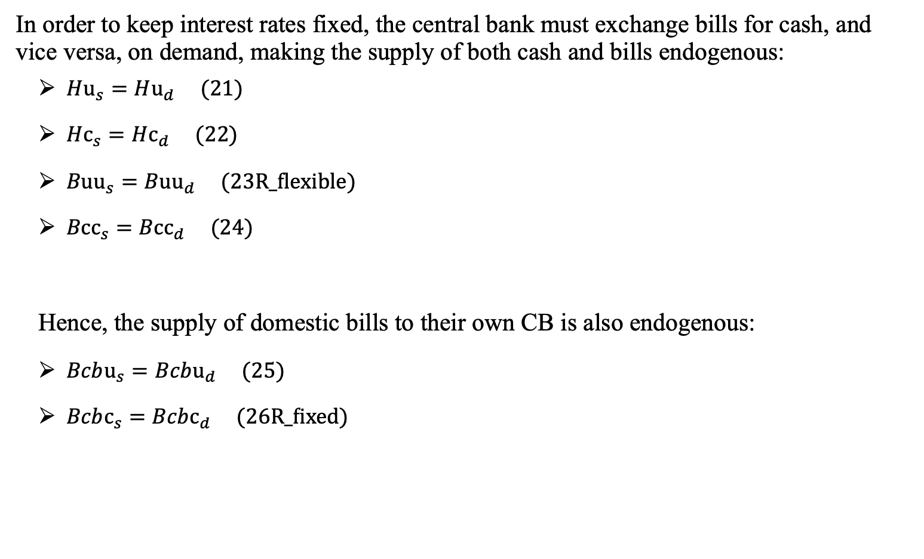
Behavior functions
In order to keep interest rates fixed, the central bank must exchange bills for cash, and vice versa, on demand, making the supply of both cash and bills endogenous:
$Hu_{s}=Hu_{d} (21)$
$Hc_{s}=Hc_{d} (22)$
$Buu_{s}=Buu_{d} (23R_flexible)$
$Bcc_{s}=Bcc_{d} (24)$
Hence, the supply of domestic bills to their own CB is also endogenous:
$Bcbu_{s}=Bcbu_{d} (25)$
$Bcbc_{s}=Bcbc_{d} (26R_fixed)$

Slide 17
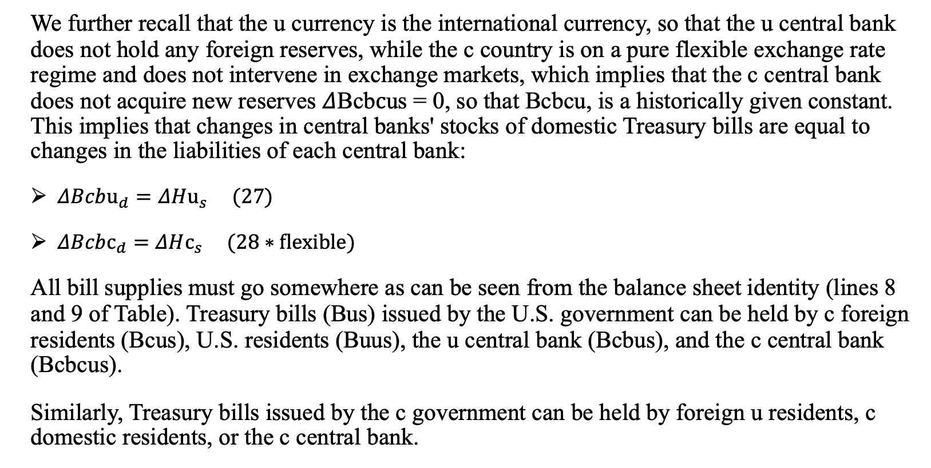
Behavior functions
We further recall that the u currency is the international currency, so that the u central bank does not hold any foreign reserves, while the c country is on a pure flexible exchange rate regime and does not intervene in exchange markets, which implies that the c central bank does not acquire new reserves $Δ$Bcb$c$us = 0, so that Bcbcu, is a historically given constant. This implies that changes in central banks' stocks of domestic Treasury bills are equal to changes in the liabilities of each central bank:
$ΔBcbu_{d}=ΔHu_{s} (27)$
$ΔBcbc_{d}=ΔHc_{s} (28∗flexible)$
All bill supplies must go somewhere as can be seen from the balance sheet identity (lines 8 and 9 of Table). Treasury bills (Bus) issued by the U.S. government can be held by c foreign residents (Bcus), U.S. residents (Buus), the u central bank (Bcbus), and the c central bank (Bcbcus).
Similarly, Treasury bills issued by the c government can be held by foreign u residents, c domestic residents, or the c central bank.

Slide 18
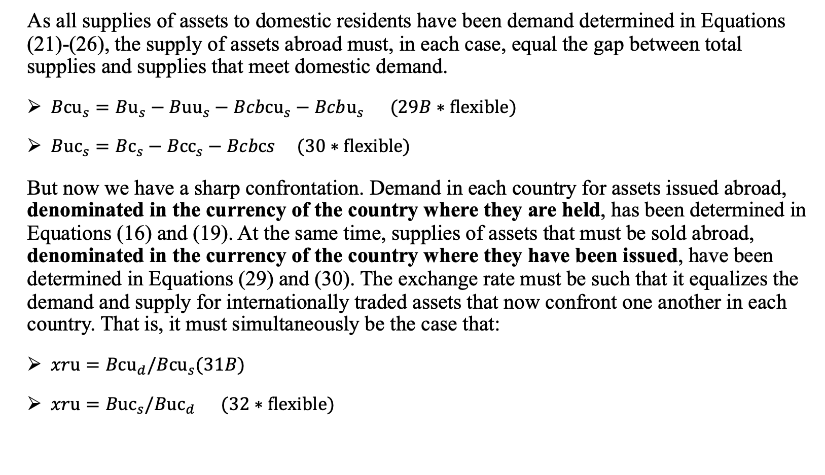
Behavior functions
As all supplies of assets to domestic residents have been demand determined in Equations (21)-(26), the supply of assets abroad must, in each case, equal the gap between total supplies and supplies that meet domestic demand.
$Bcu_{s}=Bu_{s}−Buu_{s}−Bcbcu_{s}−Bcbu_{s} (29B∗flexible)$
$Buc_{s}=Bc_{s}−Bcc_{s}−Bcbcs (30∗flexible)$
But now we have a sharp confrontation. Demand in each country for assets issued abroad, denominated in the currency of the country where they are held, has been determined in Equations (16) and (19). At the same time, supplies of assets that must be sold abroad, denominated in the currency of the country where they have been issued, have been determined in Equations (29) and (30). The exchange rate must be such that it equalizes the demand and supply for internationally traded assets that now confront one another in each country. That is, it must simultaneously be the case that:
$xru=Bcu_{d}/Bcu_{s}(31B)$
$xru=Buc_{s}/Buc_{d} (32∗flexible)$

Slide 19
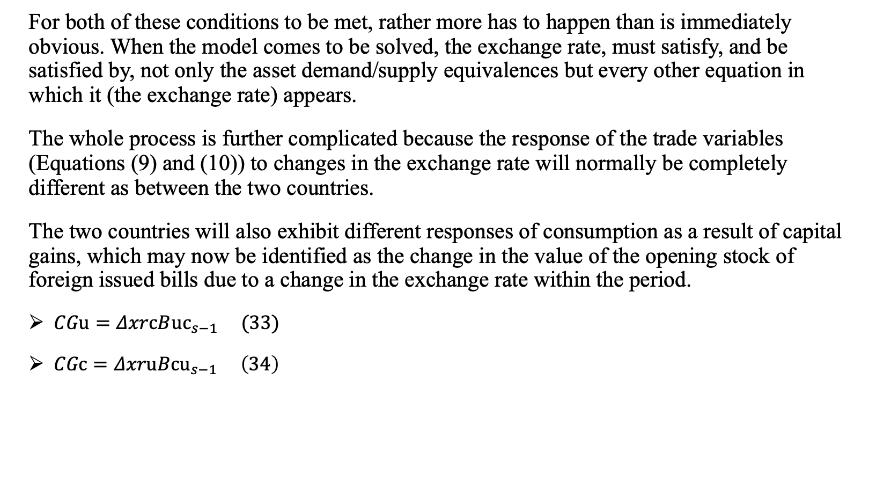
Behavior functions
For both of these conditions to be met, rather more has to happen than is immediately obvious. When the model comes to be solved, the exchange rate, must satisfy, and be satisfied by, not only the asset demand/supply equivalences but every other equation in which it (the exchange rate) appears.
The whole process is further complicated because the response of the trade variables (Equations (9) and (10)) to changes in the exchange rate will normally be completely different as between the two countries.
The two countries will also exhibit different responses of consumption as a result of capital gains, which may now be identified as the change in the value of the opening stock of foreign issued bills due to a change in the exchange rate within the period.
$CGu=ΔxrcB{uc}_{s−1} (33)$
$CGc=ΔxruBcu_{s−1} \left(34\right)$

Slide 20
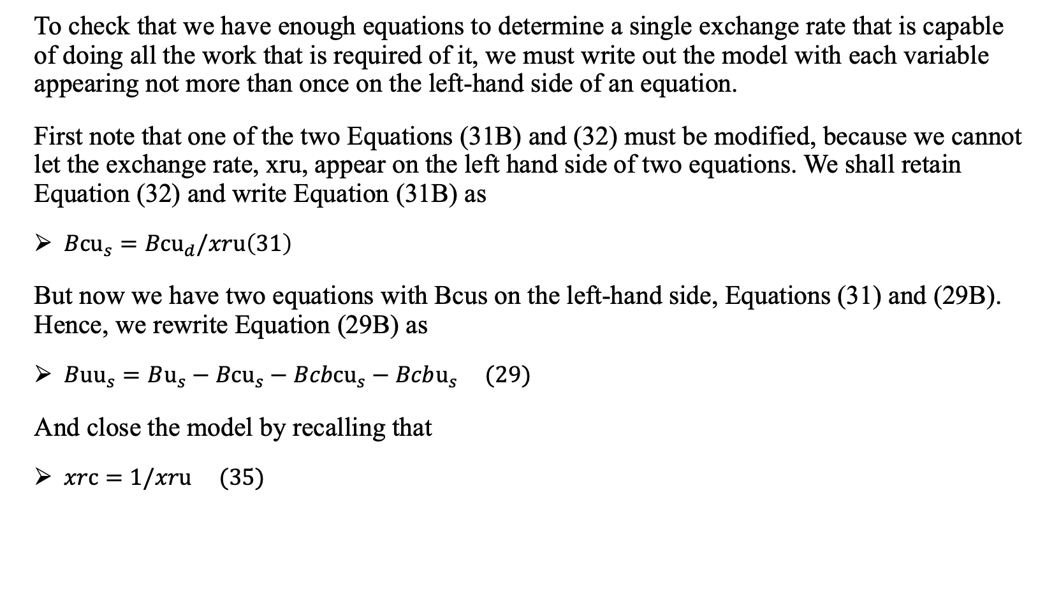
Behavior functions
To check that we have enough equations to determine a single exchange rate that is capable of doing all the work that is required of it, we must write out the model with each variable appearing not more than once on the left-hand side of an equation.
First note that one of the two Equations (31B) and (32) must be modified, because we cannot let the exchange rate, xru, appear on the left hand side of two equations. We shall retain Equation (32) and write Equation (31B) as
$Bcu_{s}=Bcu_{d}/xru\left(31\right)$
But now we have two equations with Bcus on the left-hand side, Equations (31) and (29B). Hence, we rewrite Equation (29B) as
$Buu_{s}=Bu_{s}−Bcu_{s}−Bcbcu_{s}−Bcbu_{s} (29)$
And close the model by recalling that
$xrc=1/xru (35)$

Slide 21
Behavior functions
We now have an equation in every endogenous variable, save the two interest rates that remain exogenous.
We still have two equations with Buus on the left-hand side (Equations (23R) and (29)), so we shall drop Equation (23R).
It would then seem that Buus (Equation (29)) and Buud (Equation (15)) are independent of each other. However, since the accounting of the whole system is comprehensive, the system guarantees that Buus = Buud, which is Equation (23R).
This is the "redundant" equation, which must be dropped. The two terms of this equation are equivalent without the need for any equation to make that happen-so long as every other equation is satisfied.

Slide 22
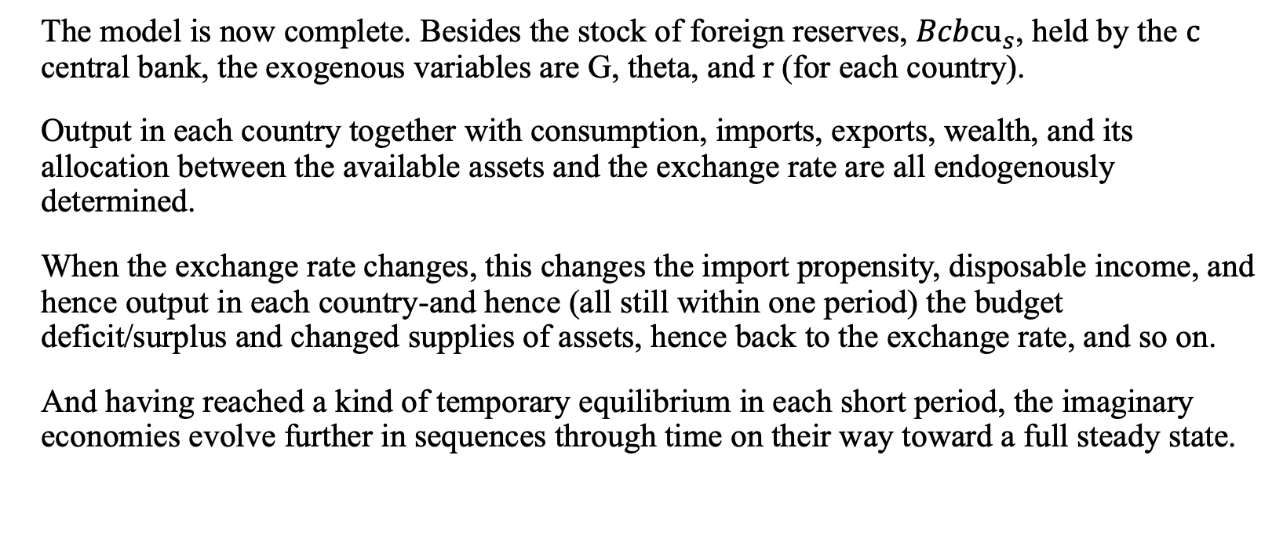
Behavior functions
The model is now complete. Besides the stock of foreign reserves, $Bcbcu_{s}$, held by the $c$ central bank, the exogenous variables are G, theta, and r (for each country).
Output in each country together with consumption, imports, exports, wealth, and its allocation between the available assets and the exchange rate are all endogenously determined.
When the exchange rate changes, this changes the import propensity, disposable income, and hence output in each country-and hence (all still within one period) the budget deficit/surplus and changed supplies of assets, hence back to the exchange rate, and so on.
And having reached a kind of temporary equilibrium in each short period, the imaginary economies evolve further in sequences through time on their way toward a full steady state.

Slide 23
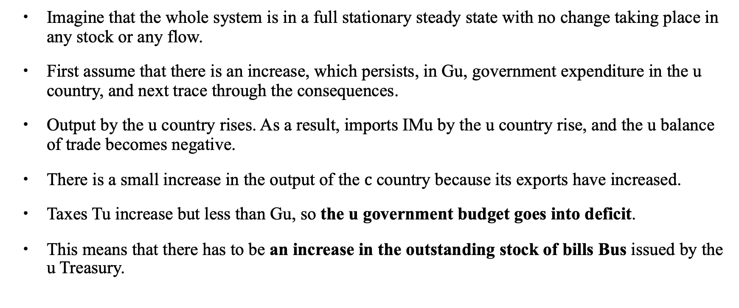
Simulation (1) Increasing government expenditure in one country (US)
Imagine that the whole system is in a full stationary steady state with no change taking place in any stock or any flow.
First assume that there is an increase, which persists, in Gu, government expenditure in the u country, and next trace through the consequences.
Output by the u country rises. As a result, imports IMu by the u country rise, and the u balance of trade becomes negative.
There is a small increase in the output of the $c$ country because its exports have increased.
Taxes Tu increase but less than Gu, so the u government budget goes into deficit.
This means that there has to be an increase in the outstanding stock of bills Bus issued by the u Treasury.

Slide 24
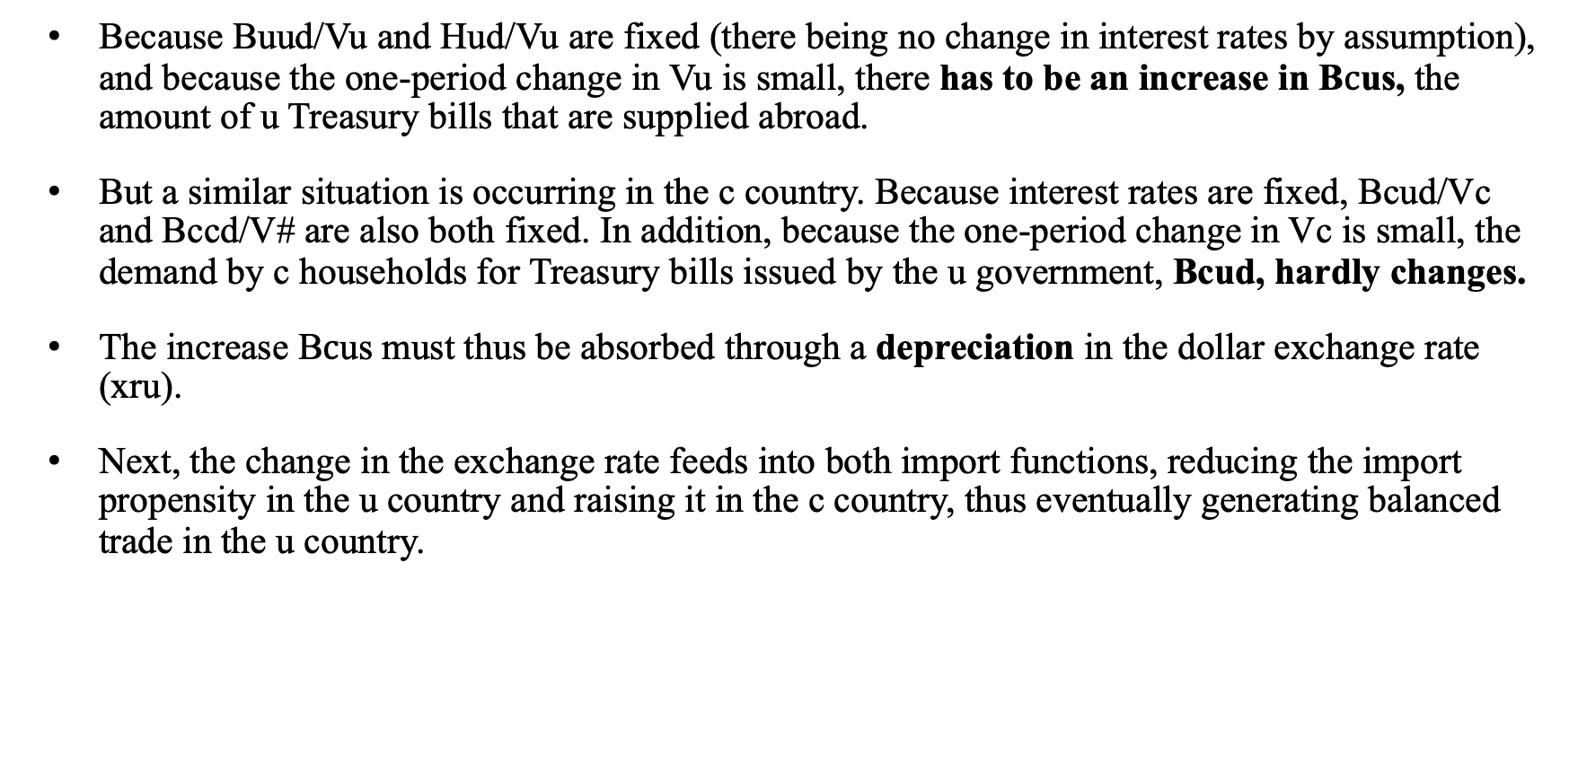
Simulation (1) Increasing government expenditure in one country (US)
Because Buud/Vu and Hud/Vu are fixed (there being no change in interest rates by assumption), and because the one-period change in Vu is small, there has to be an increase in B$c$us, the amount of u Treasury bills that are supplied abroad.
But a similar situation is occurring in the c country. Because interest rates are fixed, Bcud/Vc and Bccd/V# are also both fixed. In addition, because the one-period change in Vc is small, the demand by c households for Treasury bills issued by the u government, Bcud, hardly changes.
The increase B$c$us must thus be absorbed through a depreciation in the dollar exchange rate (xru).
Next, the change in the exchange rate feeds into both import functions, reducing the import propensity in the u country and raising it in the c country, thus eventually generating balanced trade in the u country.

Slide 25
Simulation (1) Increasing government expenditure in one country (US)
In addition, the falling dollar generates capital losses for residents in the c country where the value of the opening stock of bills issued abroad increases, and capital gains in the u country, which confronts a reduced value of bills issued in the c country.
These revaluations of wealth stocks will feed into the asset demands in both countries in the same period, and affect consumption expenditures in the succeeding period, through a wealth effect. Although the responses in the two countries are symmetrical, they will not, in general, be identical. The coefficients in the asset demand functions will, in general, be entirely different as between the two countries, yet there has to be only a single exchange rate to satisfy all the relevant responses.
The one-period solution that this model generates when shocked does not, in general, simultaneously generate a new overall steady state in which the balance-of-payments imbalance is eliminated. Rather, a new balance-of-payments deficit/surplus will occur, which will, in turn, generate a new, and similar, set of responses. So long as the exogenous variables do not change, the exchange rate will go on falling at a reducing rate until a new full steady state is achieved. Fiscal policy and also monetary policy in the form of interest rates are both under the full control of each government.
MF model: Expansionary fiscal policy causes an increase in Y, an appreciation of the currency, and a decrease in the current account balance in a floating exchange rate system.

Slide 26
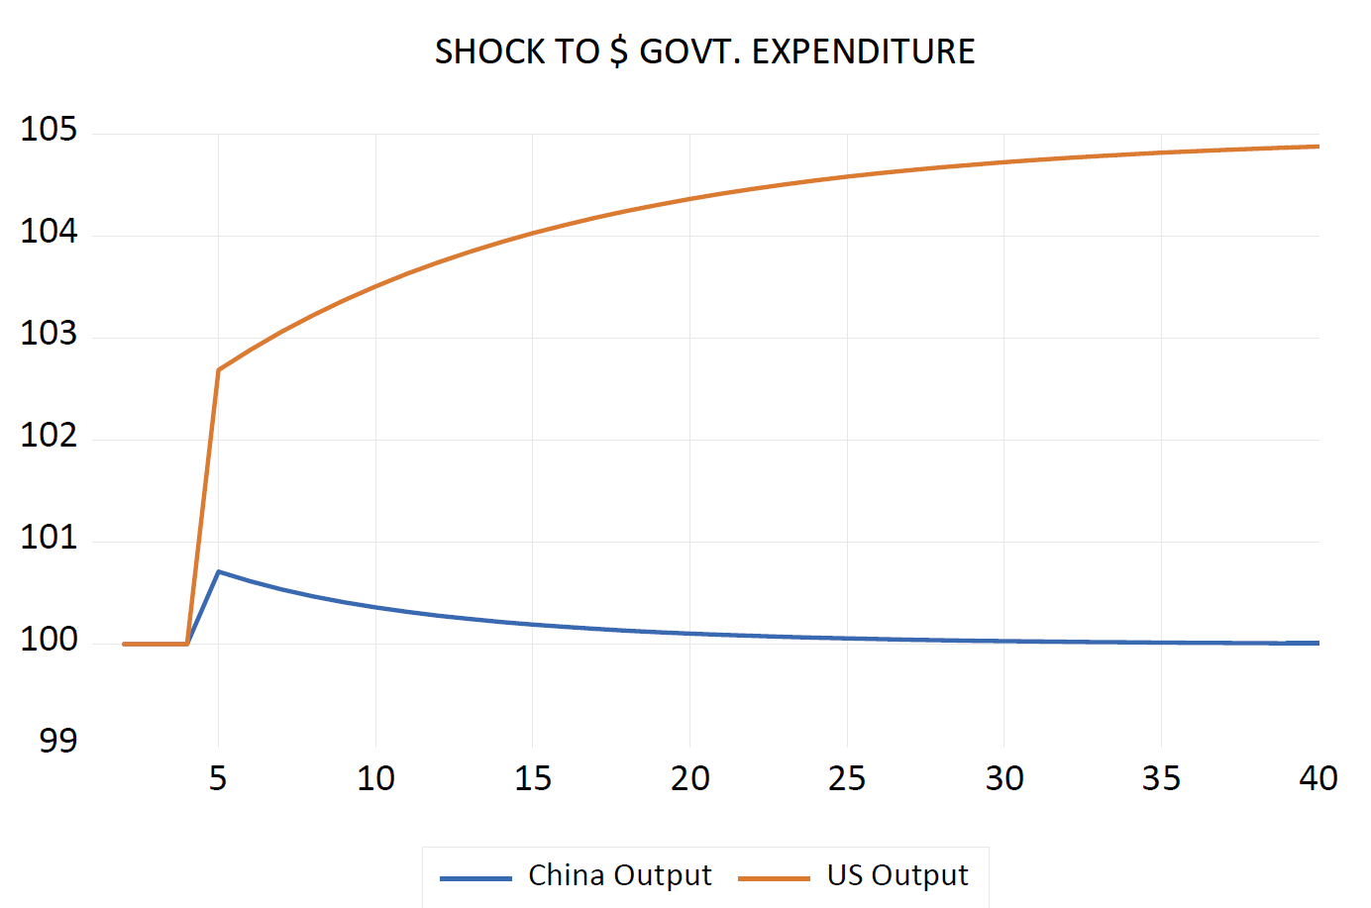
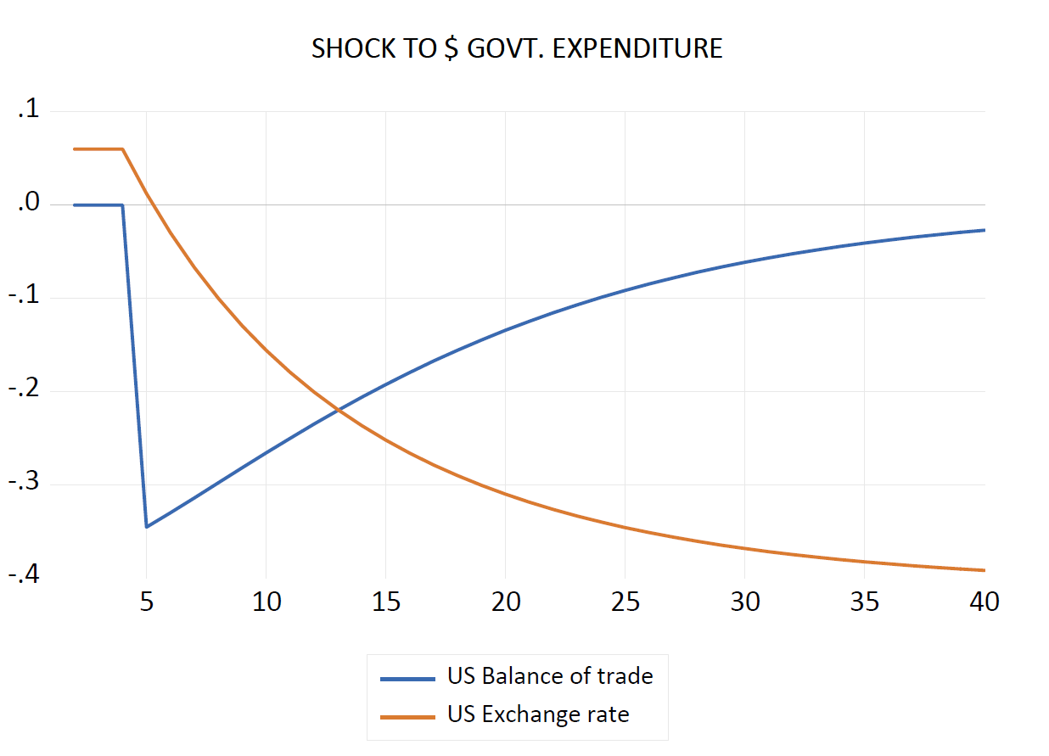
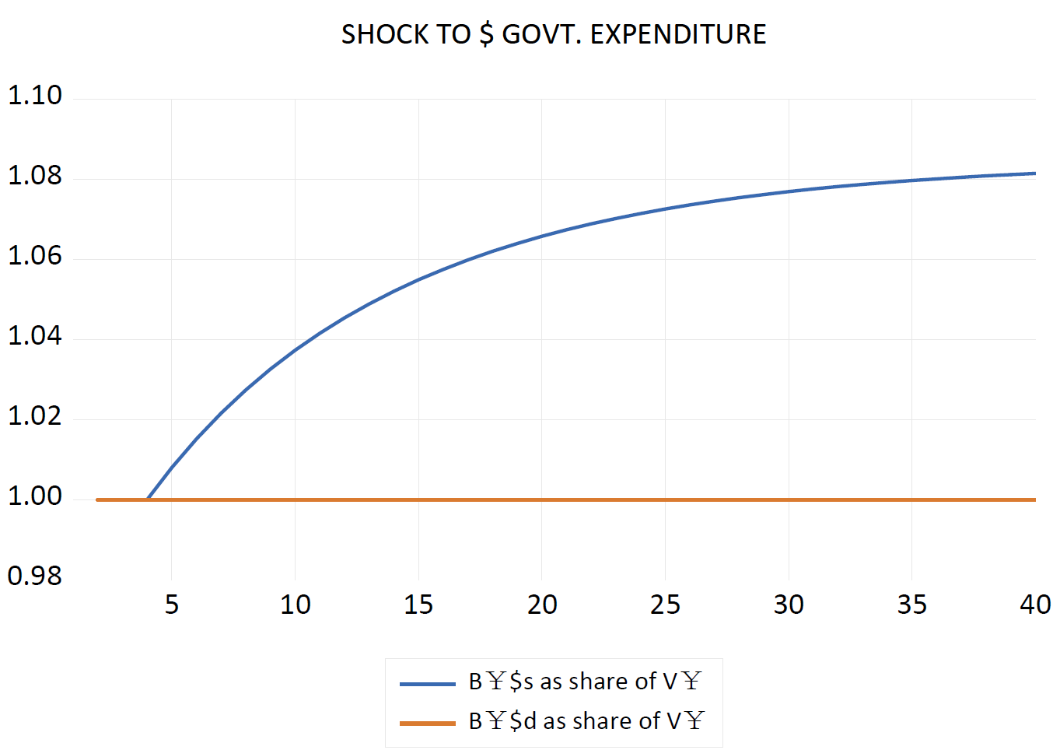
Simulation (1) Increasing government expenditure in one country (US)

Slide 27
Simulation (2) Increasing interest rate in one country (US)
The rise in the u rate of interest immediately leads to a brisk hike in the u exchange rate, the value of the dollar in c units. In other words, there is a sudden appreciation of the dollar.
The higher u rate of interest attracts net foreign capital, with all households now wanting to hold a larger proportion of u Treasury bills and a smaller proportion of c Treasury bills.
The share of u bills in c portfolios immediately rises and that of c bills in c portfolios falls by an equivalent amount so long as both shares are measured in c currency.
However, this conceals the fact that, because the exchange rate has changed, the share of u bills measured in u currency initially falls, rising only at a later stage. The initial fall is due to the fact that, since there is an approximately constant supply of u Treasury bills in the entire world, not all households will succeed in increasing their share of wealth held in the form of u Treasury bills, when measured in dollars.
Households from the c country will thus initially hold less u Treasury bills, when measured in dollars, but they will succeed in holding more of them, when measured in their local currency. This will be achieved through an appreciated dollar.

Slide 28
Simulation (2) Increasing interest rate in one country (US)
The stronger dollar will disturb the whole system by generating fiscal and trade imbalances. Because the stronger dollar will induce higher imports, the u economy will run a trade account deficit.
The trade deficit, along with the capital losses of u households on their holdings of foreign Treasury bills due to the depreciation of the c currency, will slow the u economy and propel the u government budget position into a deficit.
Because of this, u Treasury bills will have to be newly issued. The outstanding stock of Bus will rise gradually, and thus respond to the higher demand for this security. As a result, the value of the dollar will revert toward its original value, and so will the output of the u country.
US: The stronger dollar will induce higher imports, the u economy will run a trade account deficit. Trade deficit + capital losses of u households→ u government deficit→ The outstanding stock of Bus will rise →xru and the output of the u country will revert to original values.

Slide 29
Simulation (2) Increasing interest rate in one country (US)
A symmetric process will occur in the c country. The appreciation of the dollar will lead to an increase in exports and capital gains for households holding dollar-denominated securities. Both of these effects will induce an initial boost in the output of the c country, as well as a trade surplus and a budget surplus. There will thus be a reduction in the outstanding stock of c Treasury bills, Bc s, which will correspond to the reduced demand for this security caused by the higher u interest rate. This will contribute to bringing back the value of the dollar to its original value.
Thus, in this model, an increase in the interest rate leads to a slow down of the u economy through the exchange rate channel, but this negative impact is only temporary. In the new steady state, both economies are back to their initial flow levels, except that the u country, which imposed the higher interest rate, is now stuck with more substantial public debt and foreign debt.
China: The stronger dollar will induce higher exports, the c economy will run a trade account surplus. Trade surplus + capital gains of c households→ c government surplus→ The outstanding stock of Bcs will fall →xru and the output of the c country will revert to original values.

Slide 30
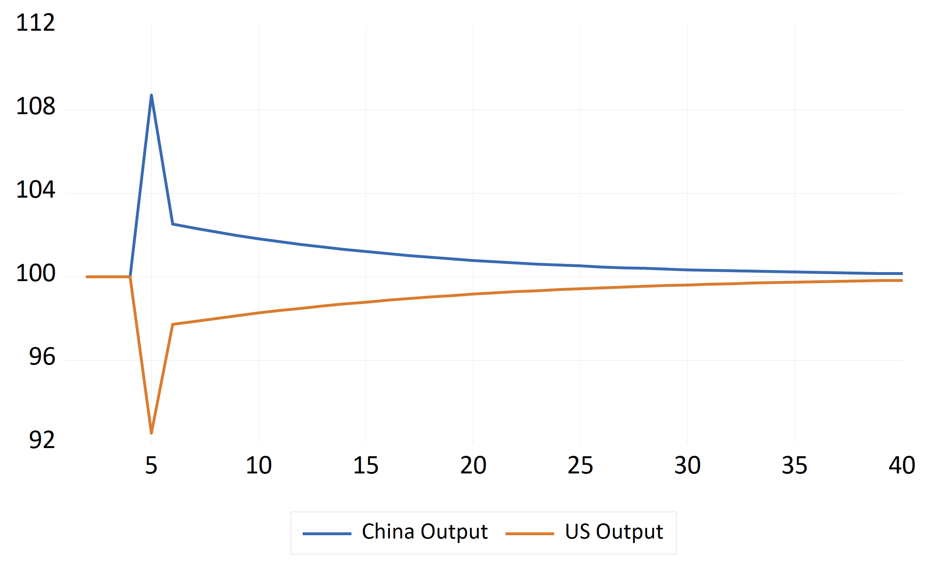
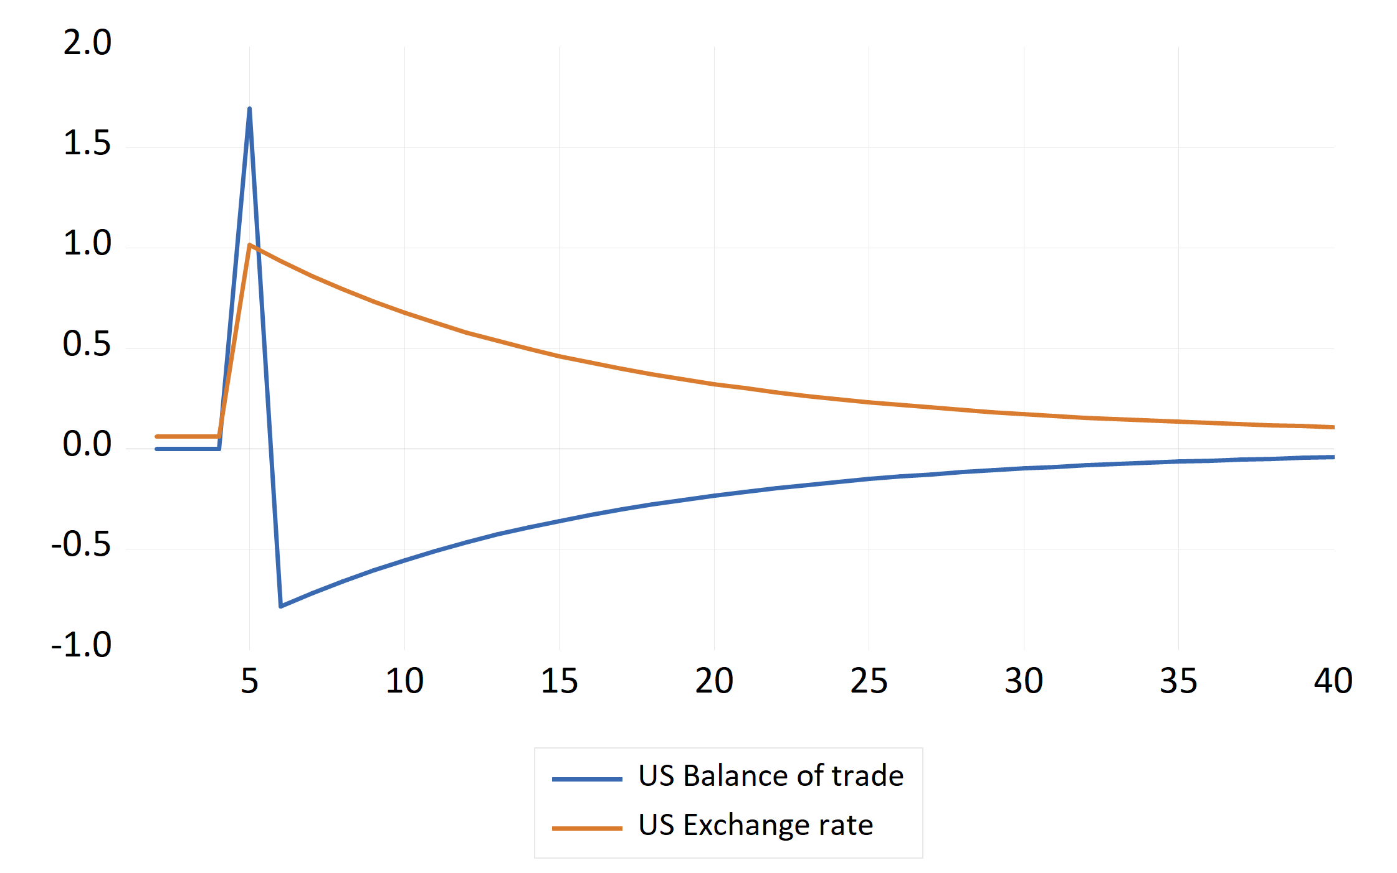
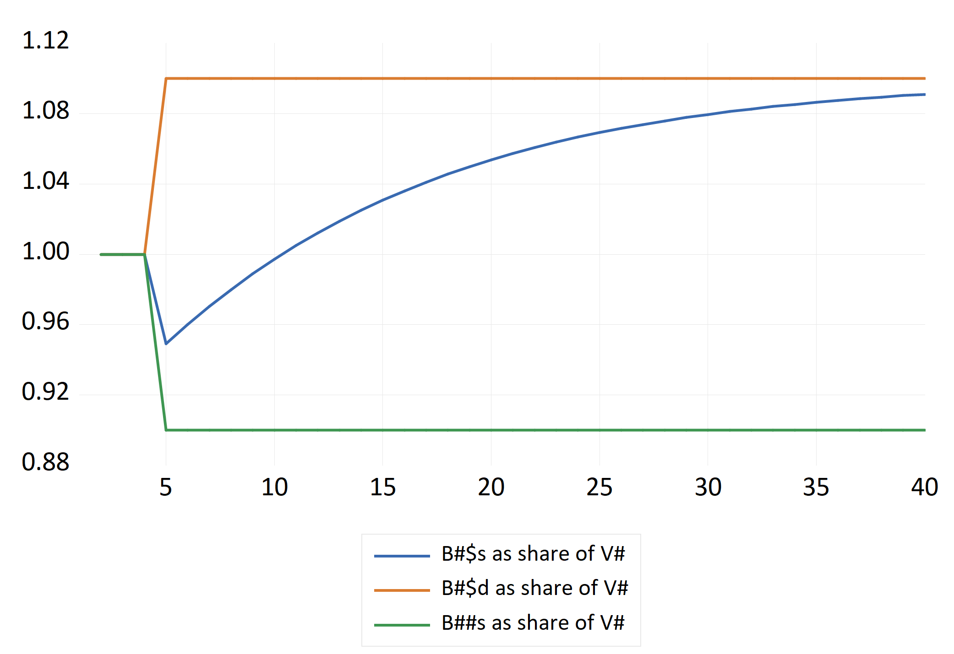
Simulation (2) Increasing interest rate in one country (US)

Slide 31
Simulation (2) Increasing interest rate in one country (US)
Changes in liquidity preference or speculative activity could be represented within the framework outlined above.
An increase in the liquidity preference of asset holders in favor of u Treasury bills would lead to the same dynamics.
This is because such a change in liquidity preference, just as an increase in the u interest rate, leads to an attempt by households to increase the share of u securities in their portfolios. Thus, such a change in liquidity preference would impose fluctuations in the exchange rate, and it would induce transitory changes in output and consumption.
In the current case, it would lead to a monetary slow down of the u economy, through the exchange rate channel. The system, by inducing a u government deficit, would create the u government assets that the investors desire.

Slide 32
Simulation (2) Increasing interest rate in one country (US)
To sum up, we see that monetary policy, defined as administered interest rate, is relatively less effective than fiscal policy, because its effect on output is only temporary, where fiscal policy has a permanent effect.
This is in contrast with M-F model, where fiscal policy is less effective in flexible exchange rate.
In addition, higher G here leads to a depreciation of u, because of the induced trade deficit.
By contrast, the M-F model concludes that higher G leads to an appreciation of domestic currency (provided the BP curve is flat, when securities are perfect substitutes, or at least fatter than the LM curve), arising from a capital account surplus. This surplus is generated by higher interest rate, caused by crowding out, which results from unrealistic assumption that CB holds constant money supply despite an increased demand for money.

Slide 33
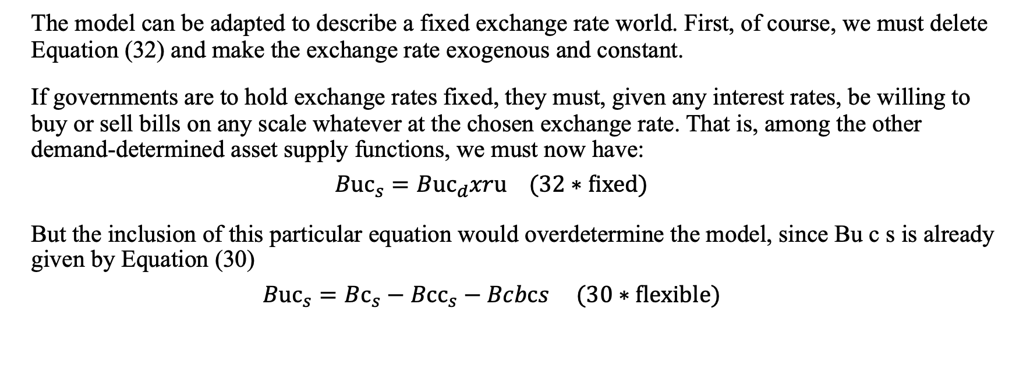
A fixed exchange regime closure
The model can be adapted to describe a fixed exchange rate world. First, of course, we must delete Equation (32) and make the exchange rate exogenous and constant.
If governments are to hold exchange rates fixed, they must, given any interest rates, be willing to buy or sell bills on any scale whatever at the chosen exchange rate. That is, among the other demand-determined asset supply functions, we must now have:
$$Buc_{s}=Buc_{d}xru (32∗fixed)$$
But the inclusion of this particular equation would overdetermine the model, since Bu c s is already given by Equation (30)
$$Buc_{s}=Bc_{s}−Bcc_{s}−Bcbcs (30∗flexible)$$

Slide 34
A fixed exchange regime closure
There are three obvious possibilities if we imagine this system out of balance.
1. The fiscal policy of the deficit country must adjust to neutralize an ex ante excess supply of bills flowing into the market (in which case it must be endogenized);
2. The (endogenous) interest rate in the deficit country must rise indefinitely so that (in theory) a continuing increase in the relative supply of bills by the deficit country is always willingly held.
3. The remaining possibility is that the central bank of the surplus country acquires (while the deficit country disposes of) reserve assets on a limitless scale.
We proceed to explore the last of these three possibilities, noting in advance that, under this assumption, both governments still retain full control over both fiscal and monetary policy.

Slide 35
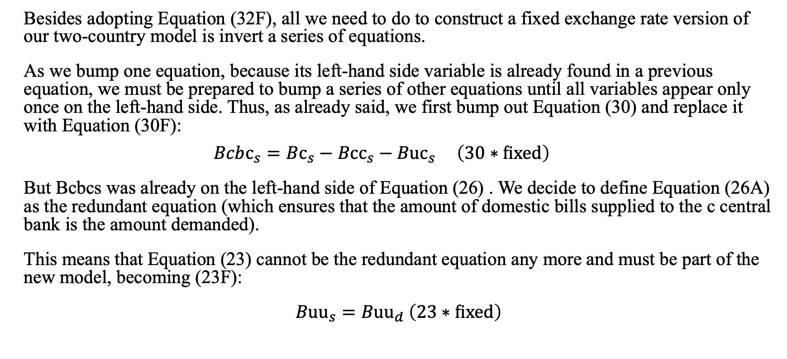
A fixed exchange regime closure
Besides adopting Equation (32F), all we need to do to construct a fixed exchange rate version of our two-country model is invert a series of equations.
As we bump one equation, because its left-hand side variable is already found in a previous equation, we must be prepared to bump a series of other equations until all variables appear only once on the left-hand side. Thus, as already said, we first bump out Equation (30) and replace it with Equation (30F):
$$Bcbc_{s}=Bc_{s}−Bcc_{s}−Buc_{s} \left(30∗fixed\right)$$
But Bcbcs was already on the left-hand side of Equation (26) . We decide to define Equation (26A) as the redundant equation (which ensures that the amount of domestic bills supplied to the c central bank is the amount demanded).
This means that Equation (23) cannot be the redundant equation any more and must be part of the new model, becoming (23F):
$Buu_{s}=Buu_{d}$ $\left(23∗fixed\right)$

Slide 36
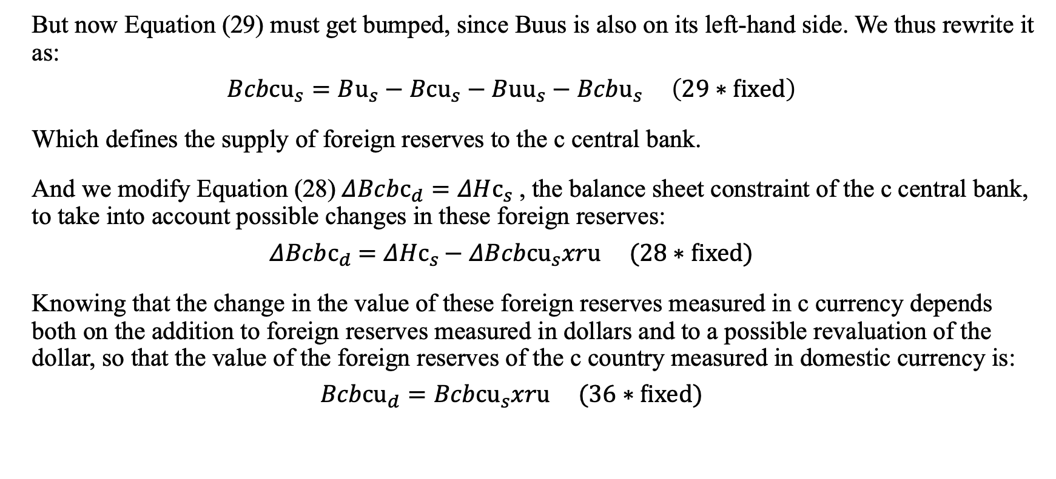
A fixed exchange regime closure
But now Equation (29) must get bumped, since Buus is also on its left-hand side. We thus rewrite it as:
$$Bcbcu_{s}=Bu_{s}−Bcu_{s}−Buu_{s}−Bcbu_{s} \left(29∗fixed\right)$$
Which defines the supply of foreign reserves to the c central bank.
And we modify Equation (28) $ΔBcbc_{d}=ΔHc_{s}$, the balance sheet constraint of the c central bank, to take into account possible changes in these foreign reserves:
$$ΔBcbc_{d}=ΔHc_{s}−ΔBcbcu_{s}xru (28∗fixed)$$
Knowing that the change in the value of these foreign reserves measured in c currency depends both on the addition to foreign reserves measured in dollars and to a possible revaluation of the dollar, so that the value of the foreign reserves of the c country measured in domestic currency is:
$$Bcbcu_{d}=Bcbcu_{s}xru (36∗fixed)$$

Slide 37
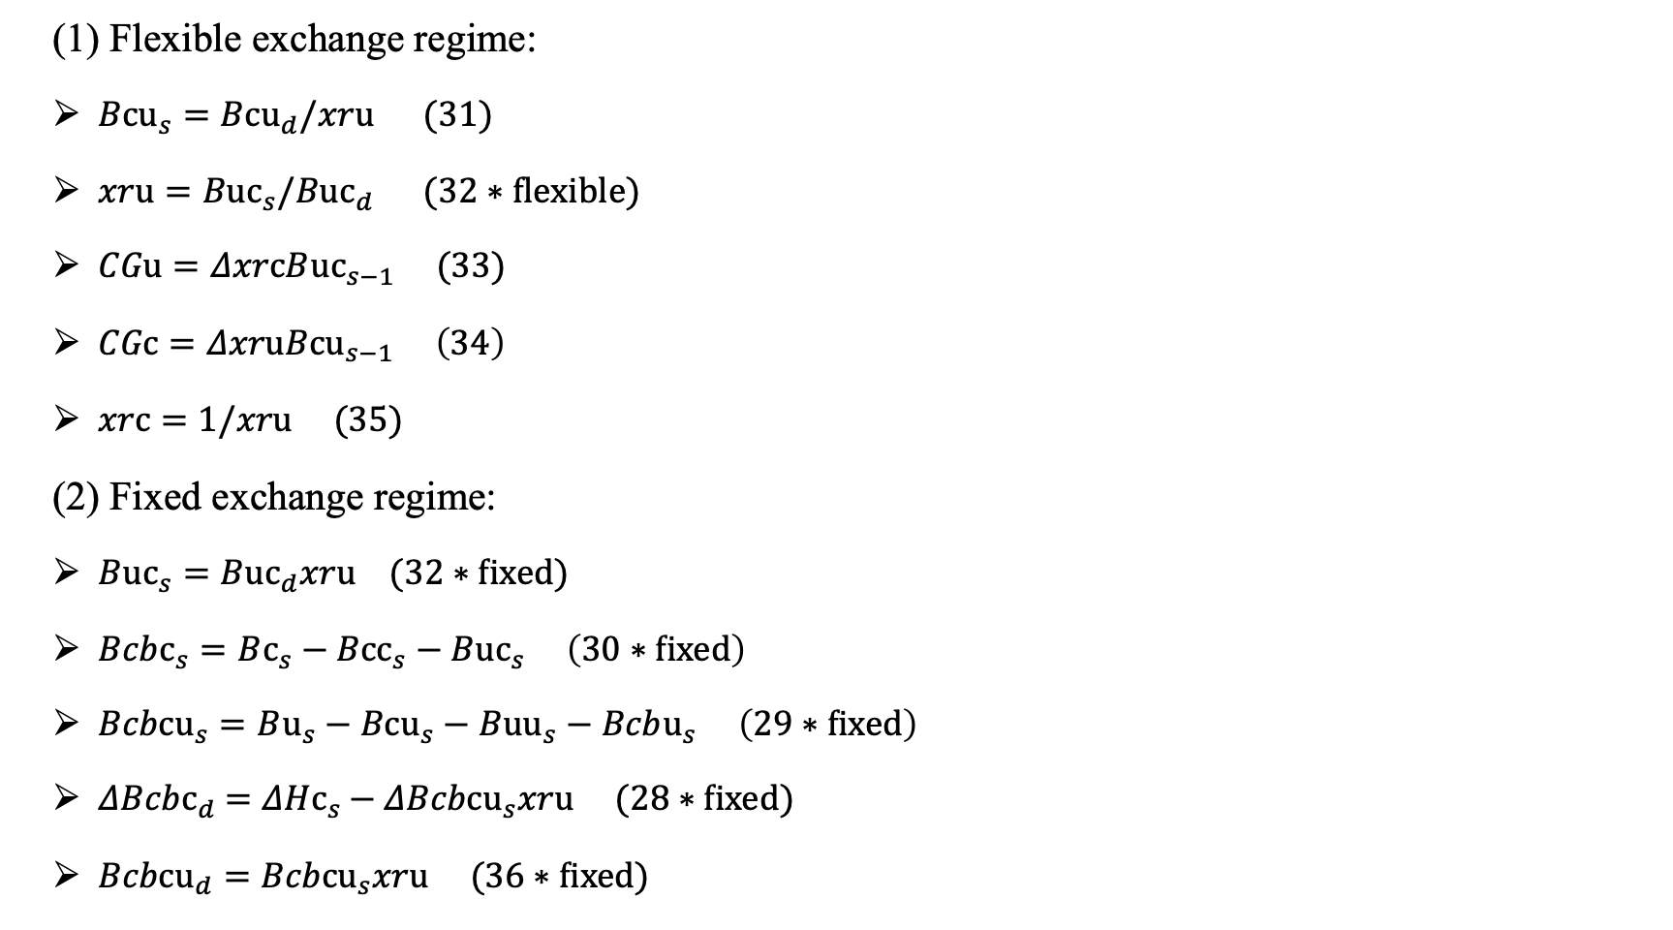
Model closure (flexible VS fixed exchange regime)
(1) Flexible exchange regime:
$Bcu_{s}=Bcu_{d}/xru (31)$
$xru=Buc_{s}/Buc_{d} (32∗flexible)$
$CGu=ΔxrcB{uc}_{s−1} (33)$
$CGc=ΔxruBcu_{s−1} \left(34\right)$
$xrc=1/xru (35)$
(2) Fixed exchange regime:
$Buc_{s}=Buc_{d}xru (32∗fixed)$
$Bcbc_{s}=Bc_{s}−Bcc_{s}−Buc_{s} \left(30∗fixed\right)$
$Bcbcu_{s}=Bu_{s}−Bcu_{s}−Buu_{s}−Bcbu_{s} \left(29∗fixed\right)$
$ΔBcbc_{d}=ΔHc_{s}−ΔBcbcu_{s}xru (28∗fixed)$
$Bcbcu_{d}=Bcbcu_{s}xru (36∗fixed)$

Slide 38
A fixed exchange regime closure
The two-country fixed exchange regime model is now complete.
The case we want to illustrate is where a surplus country (China) wishes to maintain its surplus and, in so doing, purchases reserve assets (U.S. Treasury bills) on whatever scale is necessary to keep the exchange rate where it is.
The model says that there is no limit to this process.
We start from a full stationary state (with no external imbalance) and assume that the u propensity to import rises permanently.
The Chinese economy reaches a new quasi stationary state with a constant surplus in the trade account (and in the overall balance of payments).
All flows and all privately held stocks, including the stock of money, do not change at all.

Slide 39
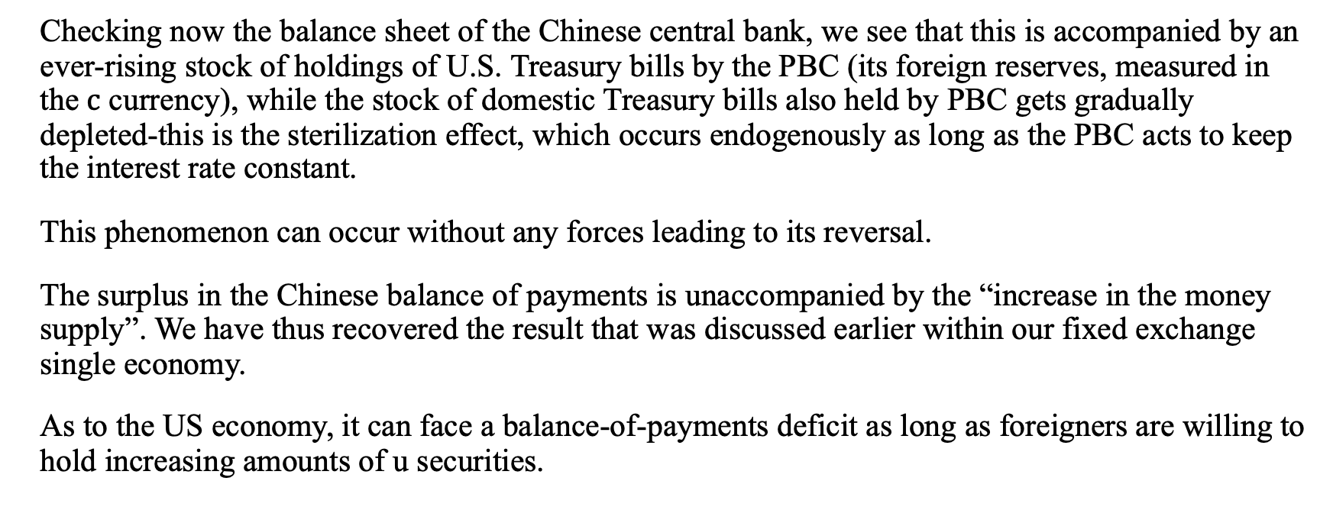
A fixed exchange regime closure
Checking now the balance sheet of the Chinese central bank, we see that this is accompanied by an ever-rising stock of holdings of U.S. Treasury bills by the PBC (its foreign reserves, measured in the $c$ currency), while the stock of domestic Treasury bills also held by PBC gets gradually depleted-this is the sterilization effect, which occurs endogenously as long as the PBC acts to keep the interest rate constant.
This phenomenon can occur without any forces leading to its reversal.
The surplus in the Chinese balance of payments is unaccompanied by the “increase in the money supply”. We have thus recovered the result that was discussed earlier within our fixed exchange single economy.
As to the US economy, it can face a balance-of-payments deficit as long as foreigners are willing to hold increasing amounts of u securities.

Slide 40
Simulation (Fixed Exchange Rate Model) Shock: an increase in the US propensity to import
1) freeze(chart1) chart1_g.line
chart1.elem(1) legend(China Output)
chart1.elem(2) legend(US Output)
2) freeze(chart2) chart2_g.line
chart2.elem(1) legend(US Balance of trade)
chart2.elem(2) legend(China Balance of trade)
chart2.elem(3) legend(Exchange rate)
3) freeze(chart3) chart3_g.line
chart3.elem(1) legend(Stock of money in China)
chart3.elem(2) legend(Foreign reserves of China central bank)
chart3.elem(3) legend(Stock of China bills held by China central bank)

Slide 41
Shock: an increase in the US propensity to import

Slide 42
A fixed exchange regime closure EXAM
In the fixed exchange rate regime, fiscal expansion leads to a permanently increased output but is accompanied by a twin deficit.
It would seem that fiscal and monetary policies are relatively more effective in the context of flexible exchange rate regimes.
Indeed, lower interest rates, unsurprisingly have only one effect-a temporary capital account deficit.
If we further assume that consumption depends negatively on interest rates, a reduction in interest rates leads to a sharp capital account deficit that quickly turns into a temporary surplus, a temporary increase in consumption and income, and a temporary budget surplus and trade deficit.
And it clearly illustrates the fact that the twin deficit proposition holds in the steady state, but not necessarily during the transition, when households accumulate or get rid of financial assets.

Slide 43
A fixed exchange regime closure
In the fixed exchange rate closure of the model, as well as its one-country version, we show why sterilization becomes endogenous when central banks fix interest rates.
Within the flexible exchange regime closure, still with monetary policy being represented by administered interest rates, we show that governments can achieve higher levels of activity by an appropriate choice of fiscal policy, at least within the limits imposed by the inflationary consequences of high activity levels (which have not been dealt with here).
This clearly contradicts the usual assertion, found in the Mundell-Fleming model, that fiscal policy has a weak or no effect in a flexible exchange regime. We have also shown that changes in interest rates, though they may have large and immediate consequences on the exchange rate and hence on levels of activity, seem to have effects that are self-reversing, thus inclining us to believe that the feedbacks tied to trade may still play a major role in the medium and long run.

